Slide 1
Lesson Two
What On Earth Is God Doing?
Satan’s Conflict With God
THE CONFLICT
FROM THE FIRST HUMAN BIRTH
THROUGH THE WILDERNESS WANDERINGS

Slide 2
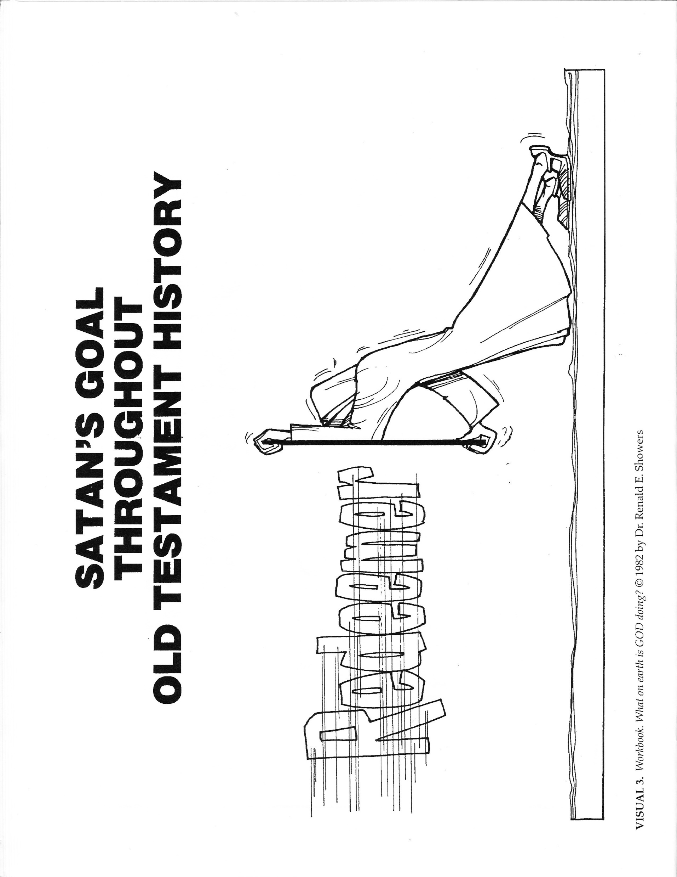

Slide 3
The First Birth and Murder
Satan was present in Eden to hear God’s first promise of the coming Redeemer. He realized that it would be fatal for him and his cause if the Redeemer were to come. Thus Satan’s primary goal throughout Old Testament history became the prevention of the Redeemer’s coming.

Slide 4
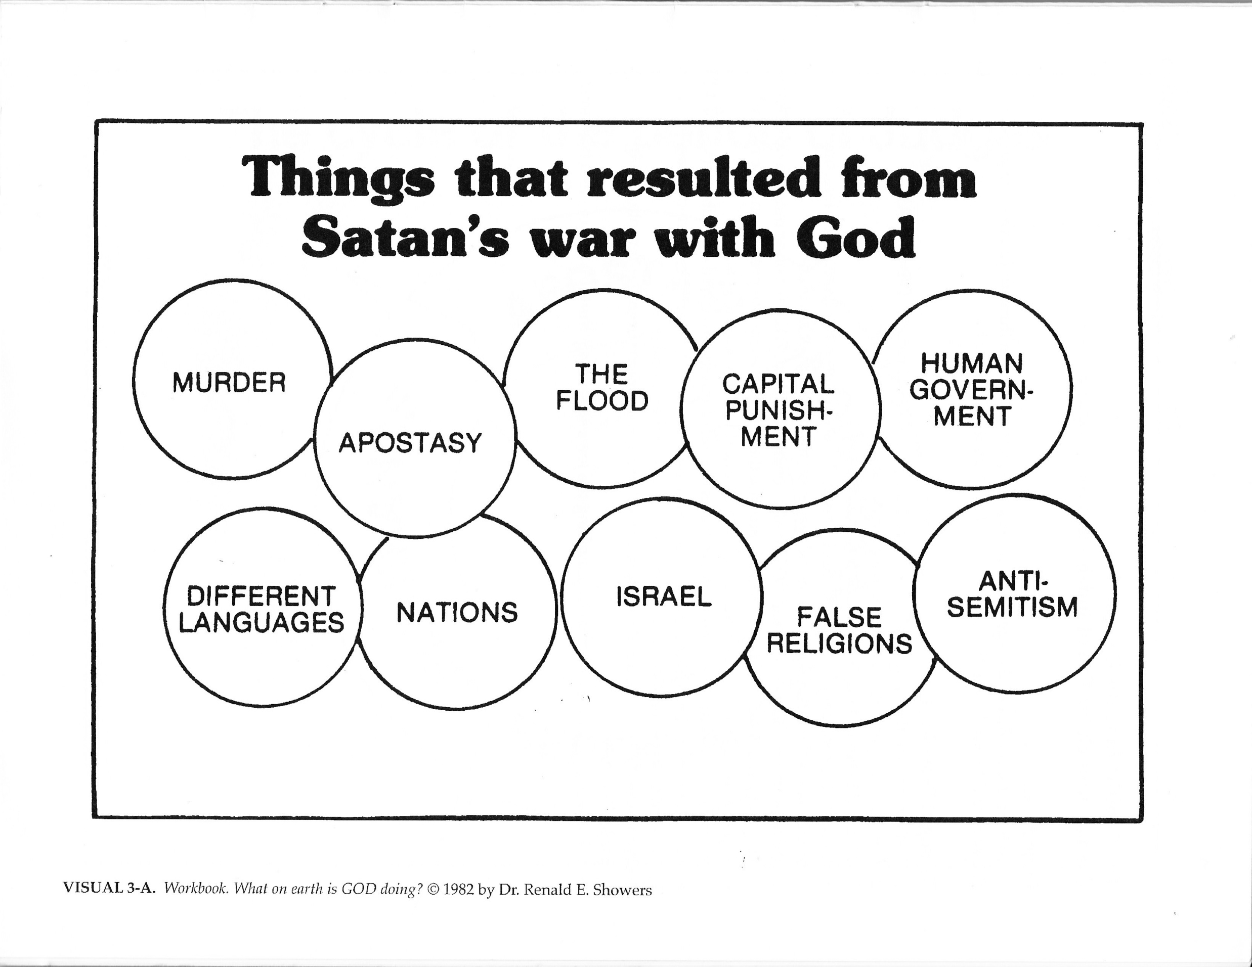

Slide 5
Sometime after Adam and Eve gave birth to Cain and Abel, it became evident that one son was godly in attitude and that the other was ungodly. Evidently Abel’s godly attitude convinced Satan that Abel was either the Redeemer or the one through whose line of descent the Redeemer would come. Thus it became imperative to Satan to get rid of Abel. Inasmusch as Cain already was controlled by a rebellious, angry attitude, it didn’t take much to prompt him to kill his brother (Gen. 4:1-8). That Satan was involved in Cain’s slaying of his brother was made evident in 1 John 3:10-12:

Slide 6
1 John 3:10-12
“10 By this the children of God and the children of the devil are obvious: anyone who does not practice righteousness is not of God, nor the one who does not love his brother, 11 For this is the message which you have heard from the beginning, that we should love one another; 12 not as Cain, who was of the evil one and slew his brother. And for what reason did he slay him? Because his deeds were evil, and his brother’s were righteous.”
Because of Satan’s involvement Christ stated that the devil “was a murderer form the beginning” (Jn. 8:44). Thus the first murder in history was committed because of Satan’s goal to prevent the Redeemer’s coming.

Slide 7
The Apostasy of the Human Race
In His war against Satan, God counteracted the murder of Abel by giving Adam and Eve another godly son named Seth.
Genesis 4:25 – Adam had relations with his wife again; and she gave birth to a son, and named him Seth, for, she said, “God has appointed me another offspring in place of Abel, for Cain killed him.”
Since this name means “substitute”, it is apparent that God meant Seth to be a substitute for Abel. The genealogies found in Genesis 5; 11:10-32; and Luke 3:23-38 reveal that God also intended the Redeemer to come through Seth’s line of descent.
It was apparent to Satan that, for every godly son he could destroy, God would raise up another to take his place. Thus Satan changed his tactic. He determined that he would pervert the whole race, including Seth’s line of descent, with apostasy. He began his attack by developing human an ungodly line through Cain. Cain and his descendants started to build an advanced civilization that was godless in outlook and was characterized by polygamy and violence (Gen. 4:16-24).

Slide 8
Through time, as Seth’s godly line had contact with Cain’s ungodly line, it, too, became infected with apostasy. In addition, evil fallen angels (“the sons of God”) began to introduce an evil angelic strain into mankind by marrying human women and fathering unique children (Gen. 6:1-4; 2 Pet. 2:4; Jude 6-7). As a result of both of these trends, the human race became so perverted that it filled the earth with violence and corruption.
Genesis 6:11-13 “11 Now the earth was corrupt in the sight of God, and the earth was filled with violence. 12 God looked on the earth and behold, it was corrupt; for all flesh had corrupted their way upon the earth. 13 Then God said to Noah, “The end of all flesh has come before Me; for the earth is filled with violence because of them; and behold, I am about to destroy them with the earth…”

Slide 9
As God looked at the situation, He “saw that the wickedness of man was great in the earth, and that every imagination of the thoughts of his heart was only evil continually” (Gen. 6:5). God was grieved that He announced His determination to destroy man from the face of the earth.
Genesis 6:6-7 6 “The LORD was sorry that He had made man on the earth, and He was grieved in His heart. 7 The LORD said, “I will blot out man whom I have created from the face of the land, from man to animals to creeping things and to birds of the sky; for I am sorry that I have made them.”

Slide 10
The Flood
Although Satan had been successful in perverting most of the human race, he was not able to pervert all of it. God counteracted him again by preserving one righteous man who was a descendant of Seth (Gen. 5:6-29; 6:9). The man’s name was Noah. In spite of tremendous pressures, Noah stood his ground and refused to be influenced by the apostate attitude and conduct of his contemporaries. God had His man. He was only one man, to be sure, but he was all that was necessary, together with his family, to carry on the godly line of Seth through which the Redeemer was to come.
God was determined to destroy the perverted human race, not just for the purpose of judgement, but also for the purpose of ending the perversion before it could infect even Noah’s descendants. Destruction was to be His instrument of preserving the line of the Redeemer so that Satan could not win the war against His kingdom.

Slide 11
God instructed Noah to build a huge ark in which Noah, his family, and representatives of every kind of birds and land animals could escape the coming destruction (Gen. 6:8-7:16). Once the occupants of the ark were safely inside, God caused the entire earth to be inundated by a cataclysmic flood (Gen. 7:10-12). The result was that every human being and every land animal outside the ark were destroyed (Gen. 7:21-23). Thus God counteracted Satan’s move to pervert the whole human race so thoroughly that the Redeemer could not come through it.

Slide 12
The New Beginning and the New Apostasy
The flood destroyed the human members of Satan’s kingdom. This gave the human race an opportunity for a new beginning with God. After the flood ended, Noah led his family in the worship of God (Gen. 8:20). Because it was the continued existence and influence of a murderer that had begun the perversion of the human race before the flood, God now instituted capital punishment for the purpose of hindering the development of perversion again after the flood.
Genesis 9:5-6 “5 “Surely I will require your lifeblood; from every beast I will require it. And from every man, from every man’s brother I will require the life of man. 6 Whoever sheds man’s blood, By man his blood shall be shed, For in the image of God He made man.”

Slide 13
This also involved the institution of human government, for a form of government was necessary to inflict the punishment. Thus capital punishment and human government were begun by God as external restraints upon man’s tendency toward perversion. Their purpose is to hinder the work of Satan’s kingdom in the world. It is for this reason that Paul wrote in Romans 13:1-6 . . .
“Let every soul be subject unto the higher powers. For there is no power but of God; the powers that be are ordained of God. Whosoever, therefore, resisteth the power, resisteth the ordinance of God; and they that shall resist shall receive to themselves judgement. For rulers are not a terror to good works, but to the evil. Wilt thou, then, not be afraid of the power? Do that which is good, and thou shalt have praise from the same; for he is the minister of God to thee for good. But if thou do that which is evil, be afraid; for he beareth not the sword in vain; for he is the minister of God, an avenger to execute upon him that doeth evil. Wherefore, ye must needs be in subject, not only for wrath but also for conscience sake. For, for this cause pay ye tribute also; for they are God’s minsters attending continually upon this very thing.

Slide 14
In a covenant with Noah, his descendants, and all animals, God promised never again to destroy all flesh with a flood. The rainbow was given as the token of this covenant (Gen. 9:8-17).
Noah uttered a prophecy concerning his descendants:
Genesis 9:25-27 25 So he said, “Cursed be Canaan; A servant of servants he shall be to his brothers.’ 26 He also said, “Blessed be the LORD, the God of Shem; And let Canaan be his servant. 27 May God enlarge Japheth, and let him dwell in the tents of Shem; And let Canaan be his servant.”

Slide 15
This prophecy foretold that God would bestow great blessing upon the line of Noah’s son, Shem (Gen. 9:26). Later revelation indicated that the Redeemer would come through Shem’s line of descent (Gen. 11:10 – 12:3).
Satan wanted to make the whole human race, including Shem’s redemptive line, apostate again. God had commanded Noah and his descendants to fill the earth with their offspring (Gen. 9:1). Mankind was “not to concentrate in some few spots but” was “to spread out so that the earth” would have “no unoccupied and uncultivated areas.” Satan, however, wanted mankind to remain close together in one area, for obvious reasons. First, it is harder to control a mass of people when they are scattered apart. Second, apostasy spreads faster and easier when people have regular, close contact with one another.
In order to keep people together, one must give them a symbol of unity or a common project to work on. Satan gave Noah’s descendants both by prompting them to build a large city and tower on the plain of Babylon to which they had migrated after the flood (Gen. 11:1-4). They were able to contemplate such a project because the entire human race spoke the same language.

Slide 16
God counteracted this move toward apostasy by causing the people to speak different languages.
Genesis 11:5-7 5 “The LORD came down to see the city and the tower which the sons of men had built. 6 The LORD said, “Behold, they are one people, and they all have the same language. And this is what they began to do, and now nothing which they purpose to do will be impossible for them. 7 “Come, let Us go down and there confuse their language, so that they will not understand one another’s speech.”

Slide 17
For the first time in human history more than one language was in existence. As a result of this confusion of language, the building activity halted, and the human race scattered over the earth (Gen. 11:8-9). Those who spoke one language in common separated from those who spoke other languages. They migrated to one part of the earth and began to build a nation on the basis of their common language. For the first time in history different nations began to form (Gen. 10:5, 20, 21-32). Thus the beginning of different languages and nations started as a result of the war between the kingdom of God and the kingdom of Satan. Genesis 11 gives a summary of the geographical distribution of the human race after the confusion of language.

Slide 18
No doubt the scattering of Noah’s descendants did slow down the spread of apostasy; however, it did not stop it altogether. Satan was determined to turn all people away from God. Through time Noah’s descendants began to suppress the truth about God. They refused to teach succeeding generations about Him, and they rejected the truths concerning God revealed through nature. They boasted that they were wise in doing this, for their denial of God’s truth made it appear that man is sovereign. Man’s willful apostasy produced two tragic results.
Man invented several idolatrous religions as substitutes for worship of the true God.
Man degenerated progressively into moral perversion. He gave free reign to vile passions and approved of gross displays of depravity (Rom. 1:18-32).
Thus false religions and the most perverted forms of depravity developed as a result of Satan’s war against the kingdom of God.

Slide 19
The Abrahamic Covenant
After nations began, God revealed that He intended to bring into existence a new nation, Israel, that would play a key role in His warfare against the kingdom of Satan. This revelation came in the form of a covenant that God made with a man whose name was changed eventually from Abram to Abraham. Abraham was a member of Shem’s line of descent (Gen. 11:10-30). In spite of Satan’s new perversion of the human race, God once again had a man who was willing to obey Him.
Heb. 11:8 “By faith Abraham, when he was called, obeyed by going out to a place which he was to receive for an inheritance; and he went out, not knowing where he was going.”

Slide 20
As a result of God’s covenant with him, Abraham moved to Canaan (Gen. 12:1-7). In the covenant, God made these promises to Abraham: personal, national, and universal. The personal promise was land (Gen. 12:1).The national promise stated that God would make of Abraham a great nation (Gen. 12:2). The universal promise stated that in Abraham, all the families of the earth would be blessed (Gen. 12:3). This was God’s way of promising in veiled terms that the Redeemer, whose redemptive work would bring blessing to all mankind, would come through Abraham’s line of descent (Mt. 1:1; Lk. 3:23-24). Thus the Redeemer’s line of descent was narrowed down to Abraham and his descendants, the nation of Israel.

Slide 21
The Sojourn in Egypt
After several generations the descendants of Abraham migrated to Egypt (Gen. 46:1-7). As they sojourned there for several centuries, God prospered them greatly (Ex. 1:1-7). By then there could have been no doubt in Satan’s mind that Israel was the nation of God’s special choosing and that God intended to send the Redeemer and fulfill His purpose for history through Israel. Satan realized that if he wanted to defeat the kingdom of God, he must destroy Israel. In Egypt he began a series of attacks upon Israel that has continued through history to the present day. Thus Satan became the author of anti-Semitism. And anti-Semitism is the result of his war against the kingdom of God.

Slide 22
In his first attempt to annihilate Israel, Satan used the stubborn will of Pharaoh, king of Egypt. Pharaoh devised a fiendish way to destroy Israel systematically (Ex. 1:8-22). He enslaves the Israelites, and orders all male Israelite infants killed to control their population growth.
Mackintosh wrote of Pharaoh: “Vain man! How little he knows of his real condition and character! He is but a tool of Satan, taken up and used by him, in his malignant efforts to counteract the purposes of God.”
God counteracted this satanic move by raising up Moses to lead Israel from Egypt to Canaan and by sending a series of ten plagues upon Egypt to break the will of Pharaoh (Ex. 2:1 – 12:28).

Slide 23
The Exodus
After the tenth plague, Pharaoh’s stubbornness was subdued. He and his people urged the Israelites to leave Egypt (Ex. 12:29-51). Thus the Exodus of Israel from Egypt began. This event proved to be one of the greatest happenings for Israel in Old Testament times.
Israel headed for Canaan. The route that she took led her toward the wilderness of the Sinai Peninsula. This journey afforded Satan several opportunities to attack the nation in various ways. The first attack came shortly after the Exodus began. Pharaoh changed his mind about letting Israel go, so he pursued the nation with his chariot force and army (Ex. 14:1-9). He appeared to have Israel trapped, for the Red Sea blocked her escape (Ex. 14:10-14). God counteracted this threat, however, by dividing the waters of the sea to enable Israel to walk across unhindered. When Pharaoh’s chariots gave pursuit, God allowed the divided waters to come together, thereby destroying Egypt’s chariot force in short order (Ex. 14:21-31).

Slide 24
The conflict over Israel continued. Satan threaten to destroy the Israelites through lack of water, then tormented them further with water unfit to drink. God counteracted this by revealing to Moses how to make the water fit (Ex. 15:22-26). Next, Satan threatened the nation with starvation, but God provided quail and a daily supply of special food called manna (Ex. 16). Satan attacked with lack of water again, but God supplied water from a rock (Ex. 17:1-7). Satan’s next tactic was an attack by the Amalekites, but God gave Israel military victory while Moses prayed (Ex. 17:8-16).

Slide 25
The Mosaic Covenant
Within three months of her departure from Egypt, Israel encamped around Mount Sinai (Ex. 19:1-2). While the nation was there, God established a covenant with her through Moses. This covenant united God and Israel to each other officially (Ex. 19:3-8). Although it has been called the Mosaic covenant, it is known more popularly as the Law (Ex. 20:1 – 23:19).
Because Israel was to be the nation through which the Redeemer would come, it was essential that she be kept free from the apostasy and perverted lifestyle of other nations. In order to insure this freedom, God placed Israel under the Law. The Law was to be an external restraint upon sinful, apostate tendencies until the Redeemer would come (Gal. 3:15 – 4:5). In order to exercise such restraint, the Law required that those guilty of apostasy and perversion be put to death immediately (Ex. 21:12-17; 22:18-20). The coming of the Redeemer was more crucial for the benefit of mankind than was the life of an individual rebel or pervert.

Slide 26
Whether or not Israel kept the Law, then, was no idle matter. In order to impress this fact upon Israel, God warned the nation that her relationship to the covenant would determine her future course of history. As long as she would keep the covenant, God would bless her more than any other nation and protect her from harm (Lev. 26:3-13; Dt. 28:1-14). On the other hand, if she would break the covenant, God would withdraw His protective presence from her and chasten her with conquest, desolation, and scattering by Gentile nations (Lev. 26:14-39; Dt. 28:15-68). God did promise, however, to preserve a remnant of the nation that would repent of any apostasy (Lev. 26:40-46). Thus the nation never would go out of existence.

Slide 27
The Threat of Apostasy
While Moses was on Mount Sinai communicating with God, Satan attacked the nation again. In the Law God had forbidden the Israelites to make or worship any image of Himself or other gods. Thus Satan knew that any idolatry on Israel’s part would stir the wrath of God against her. Therefore, he prompted the Israelites to ask Aaron to make an image that they could worship. Aaron complied, so the people indulged in idolatry and immoral practices (Ex. 32:1-6). God put an end to this apostasy by punishing only those people who participated in it (Ex. 32:7-35).

Slide 28
The Tabernacle and Sacrifices
Because of Israel’s special relationship to God, it was essential that she have a place to worship Him and that He have a place to dwell in a special sense in her midst. To this end God revealed to Moses plans for a portable worship-dwelling structure called the Tabernacle (Ex. 25 – 31). Once the Tabernacle was built and erected, the glory of God filled it as the sign of God’s protective presence in Israel (Ex. 40:34-38). God also gave Israel a system of sacrifices to be offered at the Tabernacle (Lev. 1 – 7), a priesthood to offer the sacrifices (Lev. 8 – 10), and a system of worship to be observed (Lev. 11 – 25). Although the sacrifices could not remove the sins of the people who offered them (Heb. 10:4), they did have teaching value. They taught the Israelites that the only way a sinful person can be brought into right relationship with the holy God is through a substitutionary, blood sacrifice. They also saved them from temporal judgment that would come from breaking certain parts of the Law. Symbolically they pictured ahead of time the coming Redeemer’s blood sacrifice of Himself that would take away sin completely and forever.

Slide 29
Hebrews 10:1 “For the Law, since it has only a shadow of the good things to come and not the very form of things, can never, by the same sacrifices which they offer continually year by year, make perfect those who draw near.”

Slide 30
The Failure at Kadesh-Barnea and the Wilderness Wanderings
When Israel arrived at Kadesh-barnea on the border of Canaan, Satan attacked again. He used human fear to produce unbelief, perhaps hoping that this would stir God’s wrath to destroy the nation. In spite of God’s promises to give them victory over the peoples of Canaan (Ex. 23:20-31), the Israelites panicked when their spies reported that the Canaanites were greater in size than they (Num. 13:25-33). In unbelief they slandered God and decided to return to Egypt (Num. 14:1-10). God countered this unbelief by turning the Israelites back into the Sinai wilderness to wander for forty years until those twenty years old and older would die. The older generations would not enter Canaan (Num. 14:11-35).

Slide 31
During the years of wandering, Israel was attacked again and again by Satan. He used dissatisfaction, boredom, lack of water, and foreign powers as his instruments. As a result, the Israelites rebelled against their leaders (Num. 16) and complained against God (Num. 20:2-13; 21:4-9). Thus Satan tested God’s patience, hoping that God would destroy the people through whom the Redeemer was to come. God did judge the nation each time, but He never destroyed her. When these satanic attempts failed, Satan sent Canaanites and then Amorites against Israel to destroy her (Num. 21:1-3; 21 – 35). God counteracted these attacks by giving Israel military victories. When Israel came to the Plains of Moab, Satan attacked again. Balak, king of Moab, hired the Prophet Balaam to curse Israel so that the Moabites could destroy her. God countered this move by causing the prophet to bless Israel instead of curse her (Num. 22 – 24).

Slide 32
Satan wasn’t finished using the prophet, however. Balaam devised another fiendish way to destroy Israel. He advised Balak to use the Moabite and Midianite women to seduce the Israelites into immorality and idolatry (Num. 31:16). The advice worked. In order to prevent wholesale judgment of Israel, God ordered the guilty Israelite leaders to be hanged immediately. When another Israelite man brought a pagan woman into the nation, a plague broke out among the people. It was stopped when Phinehas the priest killed the man and woman. (Num. 25:4-8). Thus, through judgment, God ended this outbreak of apostasy.

Slide 33
When the forty years of wandering were nearly ended, Moses prepared the new generations of Israelites for the conquest of Canaan (Num. 26 – 36; Dt.). He warned Israel to destroy the peoples living in Canaan. (Num. 33:50 – 34:15). These idolatrous peoples had become so perverted that their cup of iniquity was full and ripe for judgment. They were to be destroyed so that Satan could not use them to drag the Israelites into such gross apostasy and perversion as to make Israel’s total destruction necessary (Lev. 18:24-28; Dt. 12:31; 20:17-18). In other words, the coming of the Redeemer was more essential for the benefit of mankind than was the continued existence of the depraved peoples of Canaan.

