Slide 1
What on Earth is God Doing?
Satan’s Conflict With God
Renald E. Showers
Introduction

Slide 2
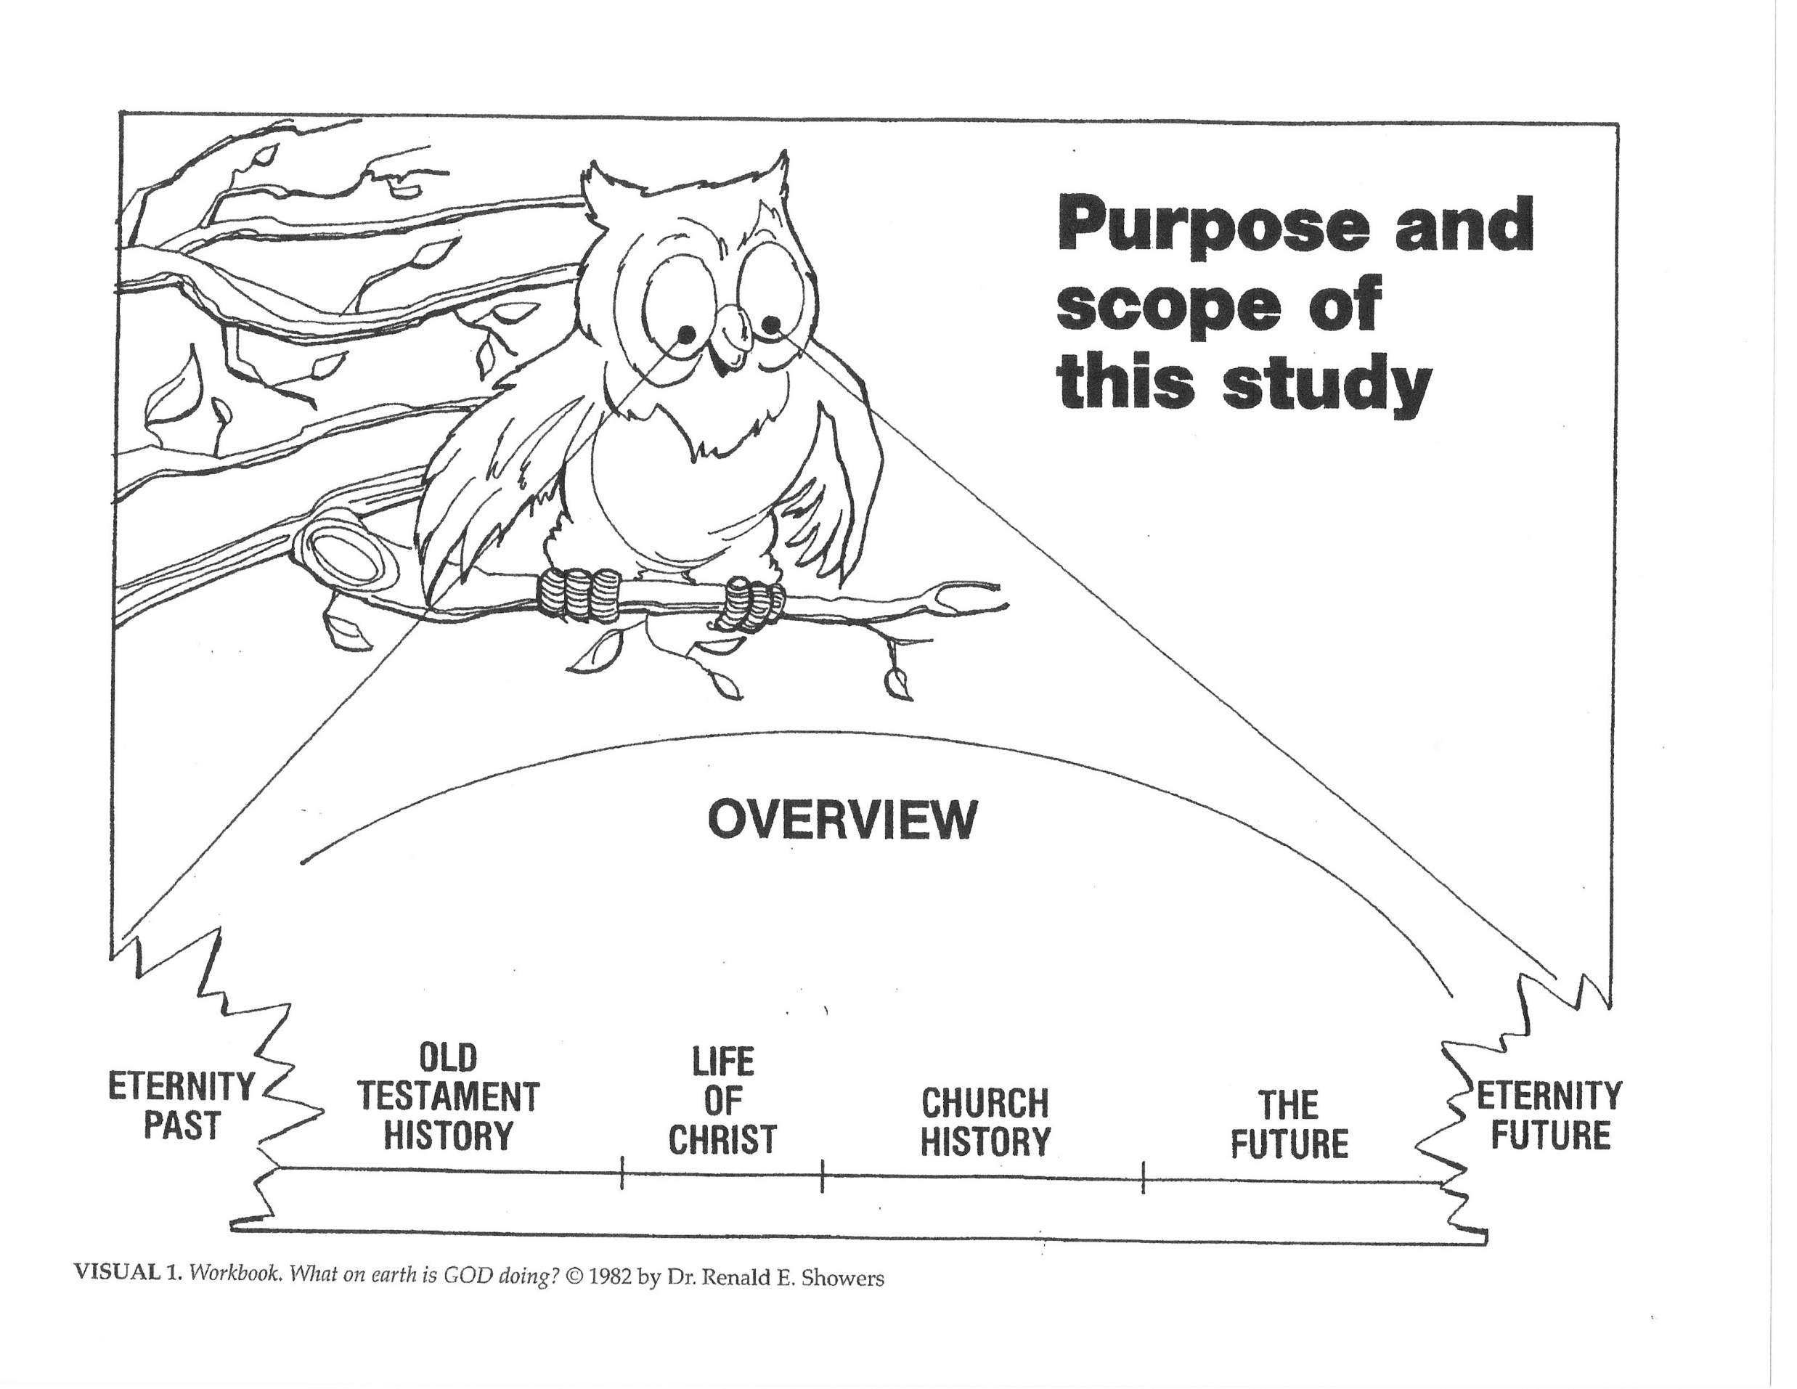

Slide 3
Lesson 1 The Setting For The Conflict
Time From Eternity Past Through Creation
The Bible’s philosophy of history begins with the eternal, personal God who existed as three distinct Persons: Father, Son, and Spirit. Prior to creation nothing else existed but God.
In eternity past God determined to have a kingdom over which He could rule as sovereign King.
1 Timothy 1:17 – “Now to the King eternal, immortal, invisible, the only God, be honor and glory forever and ever. Amen.”
Since it is impossible to have a kingdom without subjects, and since nothing else existed to serve Him, God created subjects over which He was to rule.

Slide 4
The personal, created subjects were of two major kinds.
Angelic subjects. These angels were spirit beings, not possessing bodies of flesh and bone (Mt. 22:30; Heb. 1:13-14), but they did possess intellect (2 Sam. 14:20) and the ability to communicate (Gen. 19:1-2). They were more powerful than the other kind of created beings (2 Pet. 2:11). Although made to dwell in the heavens, they were given access to earth after its creation (Gen. 19:1; Mt. 24:36). Certain angels were made superior in intelligence, power, and authority over others (Dan. 10:13; Eph. 1:21; Col. 1:16). The Bible does not reveal exactly how many angels God created, but it does mention one hundred million plus thousands of thousands more (Dan. 7:10; Heb. 12:22; Rev. 5:11).
Human Beings. Inasmuch as God created the earth to be part of His domain, He intended to have on it a kind of subject that would administer His rule over everything else on the planet. Just as some kings divide their kingdoms into provinces, place a subject as governor over each province, and hold each governor responsible to administer his province well on behalf of the king, so God created man, placed him as governor over the earth, and held him responsible to administer the earth well on behalf of God.

Slide 5
Genesis 1:26 – Then God said, “Let Us make man in Our image, according to Our likeness, and let them rule over the fish of the sea and over the birds of the sky and over the cattle and over all the earth, and over every creeping thing that creeps on the earth.” 28. God blessed them; and God said to them, “Be fruitful and multiply, and fill the earth, and subdue it; and rule over the fish of the sea and over the birds of the sky and over every living thing that moves on the earth.”
In other words, God intended the government of the earth to be a theocracy. According to The Oxford English Dictionary, a theocracy is:
A form of government in which God (or a deity) is recognized as the king or immediate ruler, and his laws are taken as the statute-book of the kingdom, these laws usually being administered by a representative or representatives as his ministers and agents.
Man had to be specially equipped in order to govern the earth for God. It was essential that he be able to understand his earthly, physical province; therefore, God formed him a physical body from the dust of the earth (Gen. 2:7). It also was necessary that he be able to receive and understand God’s directions; therefore, God created man in His own image (Gen. 1:26-28) as a personal being possessing intellect and the ability to communicate.
With the creation of man, God’s work of bringing His kingdom into existence was completed. The universal kingdom of God was a reality, and everything in it was very good by God’s perfect standard of evaluation (Gen. 1:31).

Slide 6
Time From the Fall of Angels Through the Promise of the Redeemer
Satan’s Rebellion
After creation was completed, one of the highest angels became so proud of his great intelligence and powers that he deceived himself into thinking that he could overthrow the sovereign rule of God.
Isaiah 14:12-14 – 12“How you have fallen from heaven, O star of the morning, son of the dawn! You have been cut down to the earth, You who have weakened the nations! 13 “But you said in your heart, I will ascend to heaven; I will raise my throne above the stars of God, And I will sit on the mount of assembly, In the recesses of the north. 14’ I will ascend above the heights of the clouds; I will make myself like the Most High.’
He hoped to make himself the king of the universe by establishing a kingdom of his own that would war against and destroy God’s kingdom. Because of this angel’s rebellion against God, his name was changed to Satan, which means “adversary.” He had become the great revolutionary, the enemy of God and every member of God’s kingdom. (Mt. 13:25, 28, 39; Lk. 10:18-19).

Slide 7
At this point it is important to note something about Satan. In spite of his proud plans, he will never be more than a creature of God’s. In this respect the biblical philosophy of history differs radically from those religious and philosophical systems that picture a struggle between two equal gods, one good and one evil. According to the Bible, there can be no doubt about God, the Creator, defeating Satan, the creature. In fact, God could have crushed Satan’s rebellion as soon as it began, but in His sovereign will He chose not to do so. The reason for this choice will be seen later.
The Rebellion of Other Angels
In order to establish his kingdom, Satan had to obtain subjects over which to rule. As a creature he lacked the ability to create beings. For him the only possible way to obtain subjects was by persuading God’s other creatures to join him in his rebellion. If his kingdom were to rule over both heavenly and earthly spheres, he had to persuade both angels and humans to join him.
A sizeable number of angels did join Satan’s rebellion and place themselves under his rule. There are several biblical references to Satan “and his angels” (Mt. 25:41; Rev.12:7). As a result of this angelic decision, Satan became the prince of angels (Mt. 12:24-26), the ruler of the authority of the air (Eph. 2:2). Satan organized his angels in several ranks so that they could carry on the work of his kingdom efficiently.

Slide 8
Ephesians 6:11 – “Put on the full armor of God, so that you will be able to stand firm against the schemes of the devil.”
Although a sizeable number of angels transferred their allegiance from the kingdom of God to the kingdom of Satan, a huge host of angels chose to remain faithful to God. These are called the “holy” and “elect” angels (Mk. 8:38; 1 Tim. 5:21). God remained the Lord of these hosts (Isa. 54:5; Jer. 31:35). Thus God’s kingdom continued to possess a multitude of angelic subjects within it.
In a very subtle way Satan entered man’s perfect earthly environment and tempted man to disobey a specific command of God. The bait that Satan used was the notion that, if man would disobey, he would become as God (Gen. 3:1-5).
Man’s Rebellion

Slide 9
Genesis 3:1-5 1 Now the serpent was more crafty than any beast of the field which the LORD God had made. And he said to the woman, “Indeed, has God said, ‘You shall not eat from any tree of the garden’?” 2 The woman said to the serpent, “From the fruit of the trees of the garden we may eat; 3 but from the fruit of the tree which is in the middle of the garden, God has said, ‘You shall not eat from it or touch it, or you will die.’” 4 The serpent said to the woman, “You surely will not die! 5 “For God knows that in the day you eat from it your eyes will be opened, and you will be like God, knowing good and evil.”
In other words, he was telling man that he could be his own sovereign, that he could rule his own life, if only he would rebel. In spite of God’s warning, man decided to disobey the directive of his divine King. Thus the governor of the earthly province of the kingdom of God joined the rebellion against God.

Slide 10
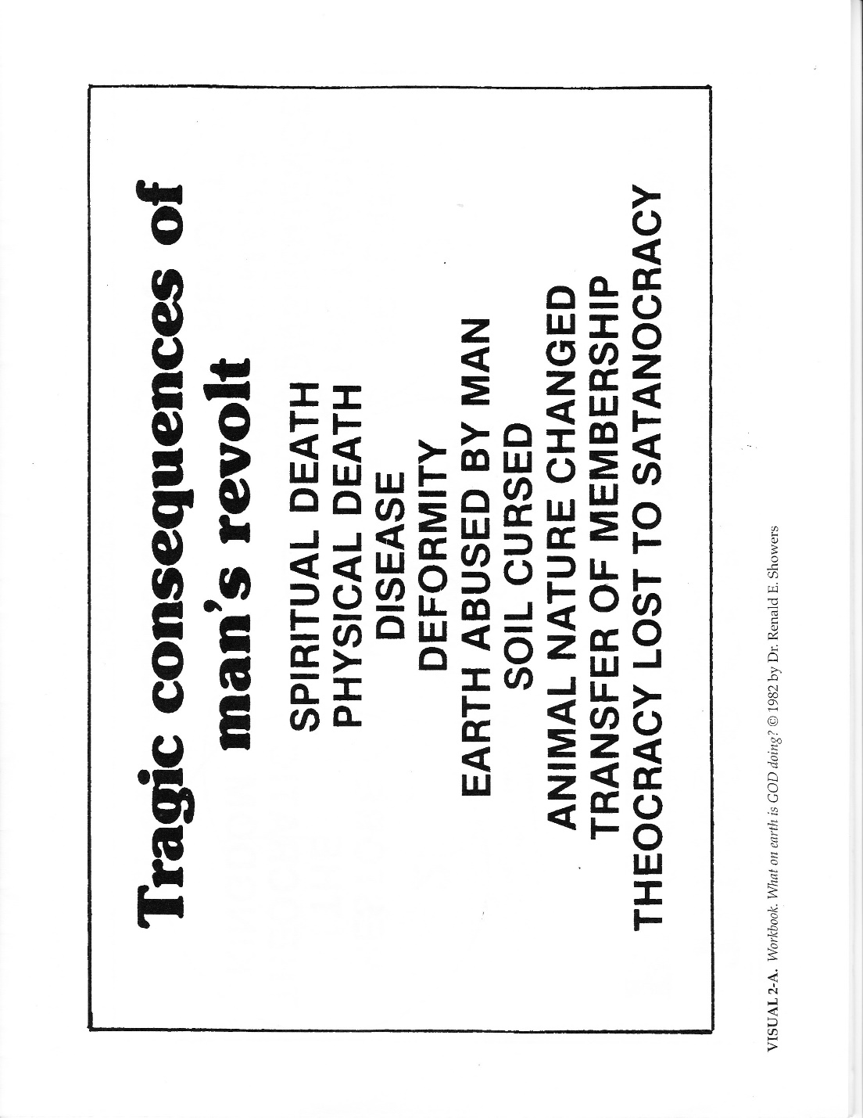
The Consequences of Man’s Rebellion

Slide 11
Man died spiritually at the moment of his disobedience.
Genesis 2:16-17 – 16“The LORD God commanded the man, saying, “From any tree of the garden you may eat freely; 17 but from the tree of the knowledge of good and evil you shall not eat, for in the day that you shall eat from it you will surely die.”
Man suffered a drastic change in his nature. God had created man with a disposition that was favorable toward God and that affected the rest of man’s nature.
When man rebelled, he lost his favorable disposition toward God and became confirmed in a disposition of enmity against God (Rom. 8:7).

Slide 12
2. Eventually, man died physically. When man rebelled, a process of decay began operating in his body. It made him subject to disease, deformity, and death (Gen. 3:19; 5:5; Rom. 5:12; 6:23; Heb. 9:27). In addition to death by decay, man became subject to death by hazards, accidents, and violence. (Gen. 4:8; 9:5-6; Lk. 13:4).
Genesis 4:8 – “…And it came about when they were in the field, that Cain rose up against Abel his brother and killed him.”
Because of his rebellion, man was denied access to a source that would cause him to live forever (Gen. 3:22-24).

Slide 13
3. Man’s ability to exercise dominion over the earth was changed. He lost ability to govern some things (Heb. 2:5-8). The ability that he did retain became perverted. As a result, he became doomed to abuse the earth. Because of his attitude of enmity against God, man began to exercise his dominion in a manner contrary to what God had intended.
4. Because man was the governor of the earthly province of God’s kingdom, his rebellion brought tragedy to his domain. A province of a kingdom often suffers as a result of its governor’s choice to rebel against the king. In man’s domain, the productive level of the soil was reduced greatly, and for the first time the soil brought forth thorns and thistles.
Gensis 3:17-18 – 17 Then to Adam He said, “Because you have listened to the voice of your wife, and have eaten from the tree about which I commanded you, saying, ‘You shall not eat from it’; Cursed is the ground because of you, In toil you will eat of it all the days of your life. 18 “Both thorns and thistles it shall grow for you; And you will eat the plants of the field.”

Slide 14
Animal nature changed drastically from a tame, non-carnivorous state (Gen. 1:30) to a wild, carnivorous state. Romans 8:19-22 indicates that all of God’s earthly creation became subject to vanity and corruption because of man’s rebellion. As a result, it continues to groan and travail in pain to the present day. Through his own sin man lost his perfect environment.
5. Man was transferred from membership in the kingdom of God to membership in the kingdom of Satan. This consequence had a tragic effect upon the whole human race. Because the original parents of the race chose to rebel against God, and because humans reproduce after their kind, every human (except Christ) born in the world is born with a disposition of enmity against God. Thus every human is born spiritually dead and a member of Satan’s kingdom.
Ephesians 2:1 – “And you were dead in your trespasses and sins.”

Slide 15
6. Because Adam, the governor of the earthly province of God’s universal kingdom, had defected from God, the theocracy was lost and Satan was able to usurp the rule of the world system away from God. The earth’s government changed from a theocracy to a satanocracy. For this reason Christ called Satan “the prince of this world” (Jn. 12:31; 14:30; 16:11); Satan had authority to offer all the kingdoms of the world to Christ (Lk. 4:5-6); some of Satan’s angels are called “the world-rulers of this darkness (Eph. 6:12); “the whole world lies in the evil one” (1 Jn. 5:19); and Satan dominates the present age of the world so completely that the apostle Paul called him ”the god of this age” (2 Cor. 4:4).
These tragic consequences reveal that man had been duped by Satan into believing a lie.
John 8:44 – “You are of your father the devil, and you want to do the desires of your father. He was a murderer from the beginning, and does not stand in the truth because there is no truth in him. Whenever he speaks a lie, he speaks from his own nature, for he is a liar, and the father of lies.”

Slide 16
The Purpose of History
Now there were two opposing kingdoms in existence. The kingdom of Satan had attacked the kingdom of God with the goal of destroying it. If God were to remain sovereign, He must crush Satan and his kingdom. Thus the stage was set for a fantastic conflict – the conflict of the ages. This conflict would be waged both in the heavens and on the earth (Rev. 12:7, 13, 17; Eph. 6:10-12).
Revelation12:7 – “And there was war in heaven, Michael and his angels waging war with the dragon. The dragon and his angels waged war.”
Ephesians 6:10-12 – 10 Finally, be strong in the Lord and in the strength of His might. 11 Put on the full armor of God, so that you will be able to stand firm against the schemes of the devil. 12 For our struggle is not against flesh and blood, but against the world forces of this darkness, against the spiritual forces of wickedness in the heavenly places.”
Since the Bible is God’s written revelation to man, it deals primarily with the earthly phase of the conflict.

Slide 17
This conflict of the ages provides the key for unlocking the mystery of the ultimate purpose of history. Both God and Satan have a purpose for history; but since God is God, and Satan is only a creature, God’s purpose is the ultimate one. Satan’s purpose for history is to make himself the only sovereign king of the universe by establishing his kingdom as the only permanent one of the heavens, the earth, and all that is in them. When first set up, his kingdom was not permanently established as an everlasting one. It could become such only if Satan could crush God and His kingdom. This he has been attempting since his own rebellion began, and the attempt will continue almost to the end of the present world’s history.
God’s purpose for history is to glorify Himself by demonstrating the fact that He alone is the sovereign God of the universe. Inasmuch as God’s purpose for history is the ultimate one, it is correct to conclude that the ultimate purpose for history is for God to glorify Himself by demonstrating His sovereignty.
In order to demonstrate His sovereignty during history, God must restore the present earth to the basic original condition it enjoyed before man’s rebellion. Old Testament prophets received revelation to the effect that He would do just that (Acts 3:21). It is important to note that the restoration must take place on this present earth, not the new earth to be created by God for eternity future.

Slide 18
Revelation 21:1 – Then I saw a new heaven and a new earth; for the first heaven and the first earth passed away, and there is no longer any sea.”
Should God permit the present earth to pass away at the end of history with restoring it to its original conditions, it would appear that He was incapable of overcoming the devastating work of Satan and his kingdom. Thus there would be no demonstration of divine sovereignty during history.

Slide 19
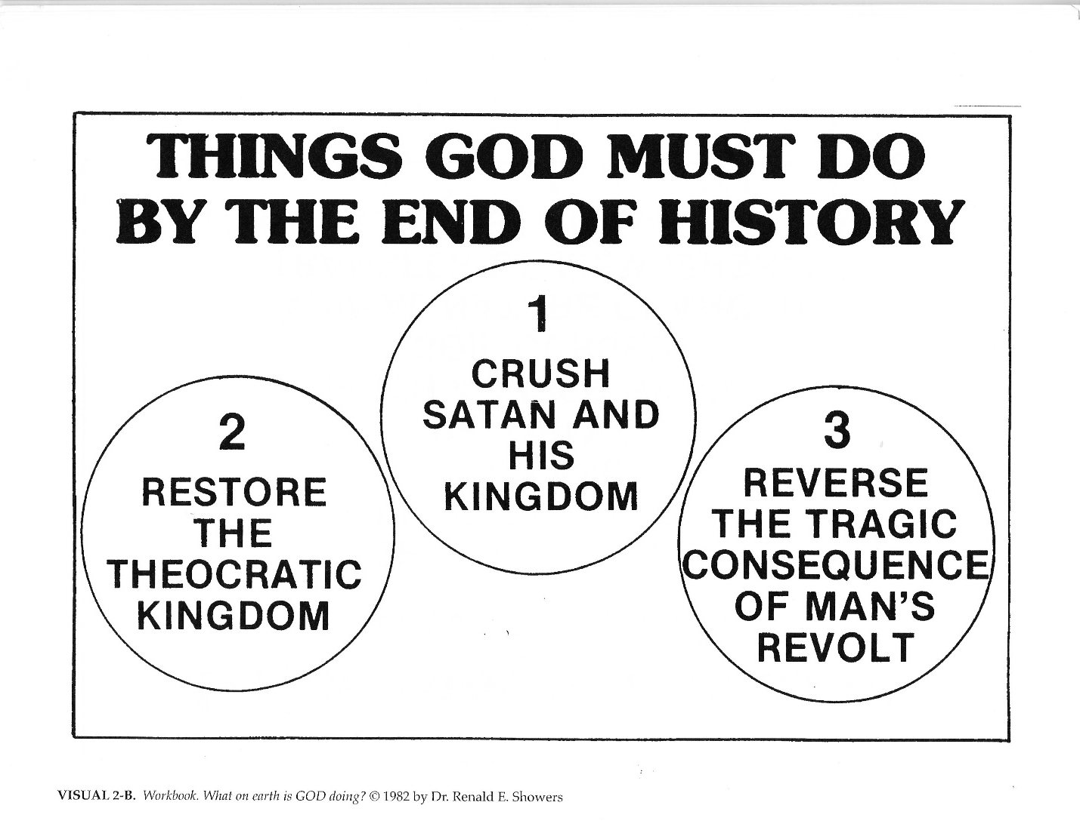

Slide 20
The First Promise of the Coming Redeemer
In light of the necessity for God to crush Satan and his kingdom in order to demonstrate divine sovereignty, it is interesting to note that no sooner had Satan usurped the world system for his kingdom than God delivered a prophecy concerning Satan’s doom.

Slide 21


Slide 22
Genesis 3:14-15 – 14“The LORD GOD said to the serpent, Because you have done this, Cursed are you more than all cattle, And more than every beast of the field; On your belly you will go, And dust you will eat All the days of your life; 15 And I will put enmity Between you and the woman, And between your seed and her seed; He shall bruise you on the head, And you shall bruise him on the heel.”
In this prophecy God addressed Satan in the subtle form that he had taken to tempt man. God forewarned Satan that eventually a man born of a woman would deliver a devastating blow to him. Later Scripture revealed that this prophecy was God’s initial way of promising that a Redeemer would do the work necessary to crush Satan’s kingdom and work. In other words, the Redeemer was to be God’s Counterrevolutionary who would make possible the defeat of the great revolutionary. The Redeemer, then, was to be the key to the fulfillment of God’s purpose for history.

Slide 23
In order for God to reverse the consequences of man’s sin, it was necessary to get rid of the cause of the consequences. This meant getting rid of human sin. Later Scripture revealed that only the payment of an adequate penalty to divine justice could remove man’s sin. It also revealed that death was the only adequate penalty (Rom. 5:12; 6:23). Because of this, in the Genesis 3:15 prophecy God foretold that, while the Redeemer would crush Satan, Satan would bruise Him. This was God’s way of saying that, as a result of Satan’s work, the promised Redeemer would suffer death in order to defeat Satan. Later Scripture revealed that through His death the Redeemer would pay the penalty for man’s sin, thereby causing the removal of sin (Isa. 53:4-6, 10-12; Jn. 1:29) and making it possible for God to reverse the consequences of man’s rebellion.

Slide 24
The Strategy of the Conflict
Genesis 3:15 made it evident that God intended the Redeemer to be the heart of His strategy in the war against Satan. The Redeemer, however, would not be the only person to serve the kingdom of God in the conflict. The holy, elect angels would fight the forces of Satan (Dan. 10:20; Rev. 12:7). Through the redemptive work of the Redeemer, God would save people out of Satan’s kingdom and make them members of His own kingdom.
Galatians 1:4 – “…who gave Himself for our sins so that He might rescue us from this present evil age, according to the will of our God and Father…”
Colossians 1:13 – “For He rescued us from the domain of darkness, and transferred us to the kingdom of His beloved Son…”
These redeemed humans would remain in the world for the rest of their lives to act as representatives of the kingdom of God in the world system dominated by Satan. Although they would live in Satan’s world system, they would not belong to it. (Jn. 17:14-18). They would be strangers and pilgrims in the world with their citizenship in heaven (Eph. 2:19; Phil. 3:20; Heb. 11:13; 1 Pet. 1:17).

Slide 25
Occasionally God also would use nations and even unsaved people to serve His purposes (Isa. 10:5-6; 44:28 – 45:5; Jer. 25:9). Thus, although God’s kingdom would not exist in a world-wide theocratic form during certain periods of history, it would be represented and working in the world during every period of history. This continuing function of the universal kingdom of God in the world system dominated by Satan helps to explain the continuing presence of good alongside of evil in the world (Matt. 13:24-30, 36-43).

Slide 26
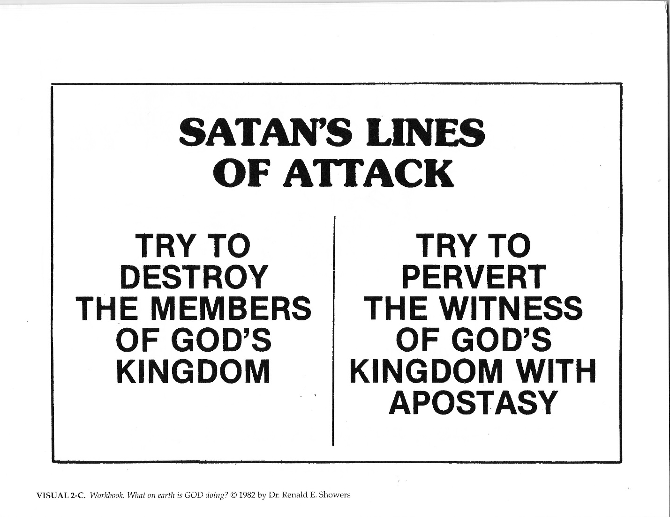

Slide 27
Since the coming and work of the Redeemer would be the key to God’s strategy, the key to Satan’s strategy would be the preventing of the Redeemer’s coming and work. In addition, Satan would war against the holy angels and redeemed humans who would represent God’s kingdom in the world (Dan. 10:13, 20-21; Eph. 6:11, 16). He would use his fallen angels, the human members of his kingdom, nations, and occasionally even humans from God’s kingdom to do his work (Job 1:9-15, 17; Dan. 10:13, 20-21; Mt. 16:21-23; Lk. 22:3; Acts 5:1-3; Eph. 6:12; 2 Th. 2:9).
A study of the Scriptures indicates that Satan intended to use interchangeably two different lines of attack:
Try to destroy the members of God’s kingdom
Try to pervert the witness of God’s kingdom with apostasy in belief or practice.
Both tactics will be observed repeatedly as the drama of the conflict unfolds.

